Slide 1


TERM PROJECT
MADE BY :
PRAJJWAL SINGH(185081)
ALOK KUMAR(185075)
AZHAN ALI(185096)

Slide 2
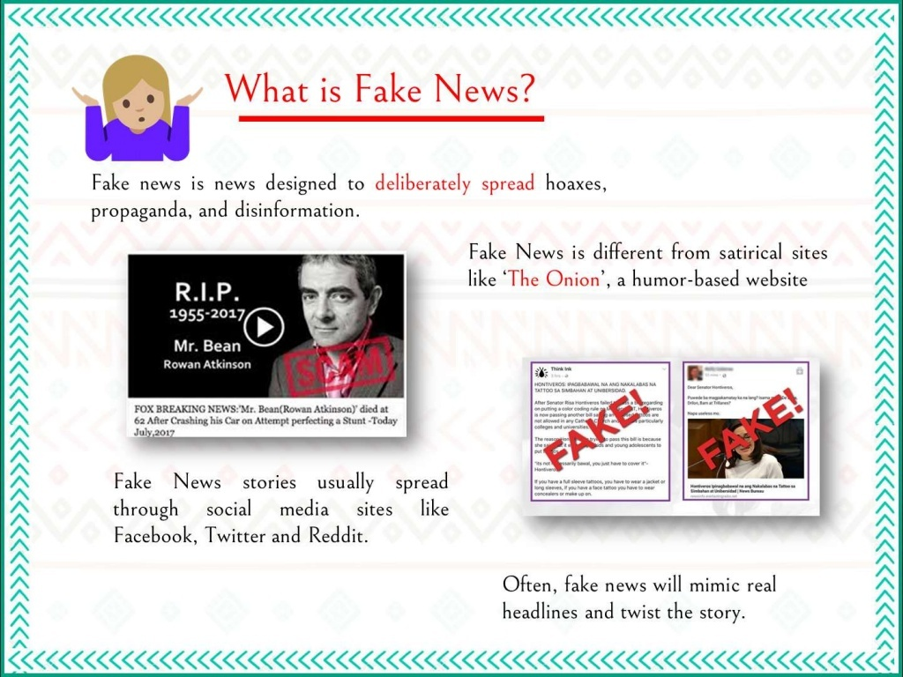

Slide 3
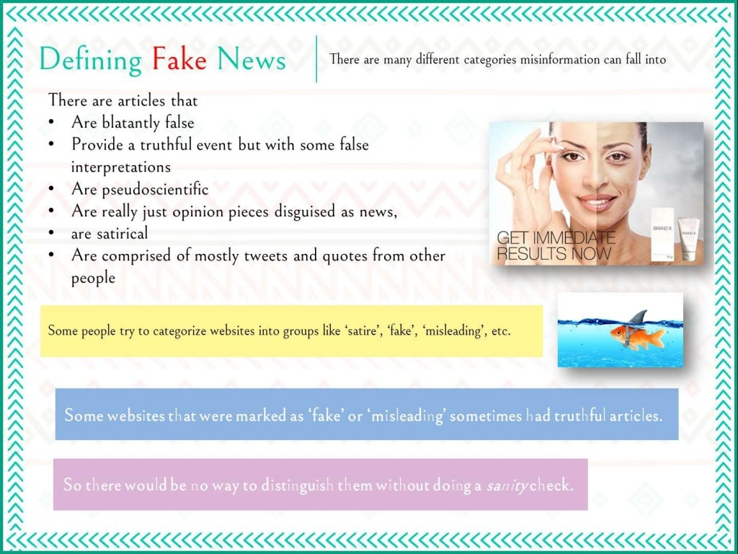

Slide 4
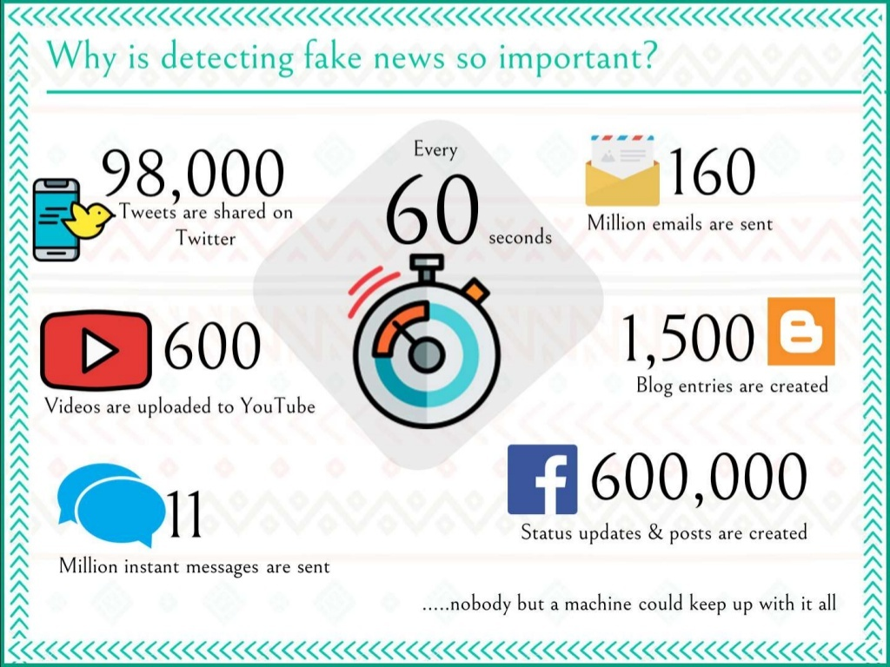

Slide 5
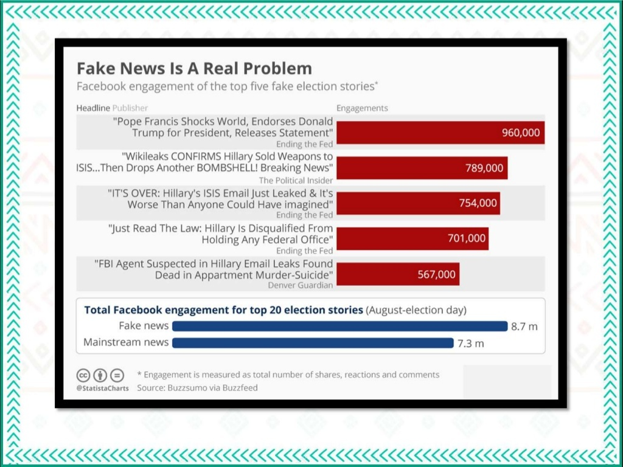

Slide 6


Slide 7


Slide 8


Slide 9
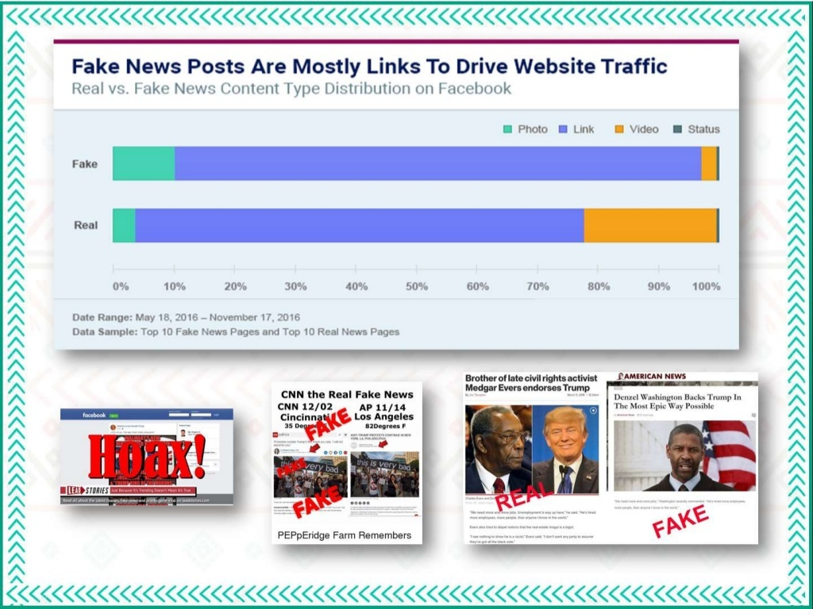

Slide 10
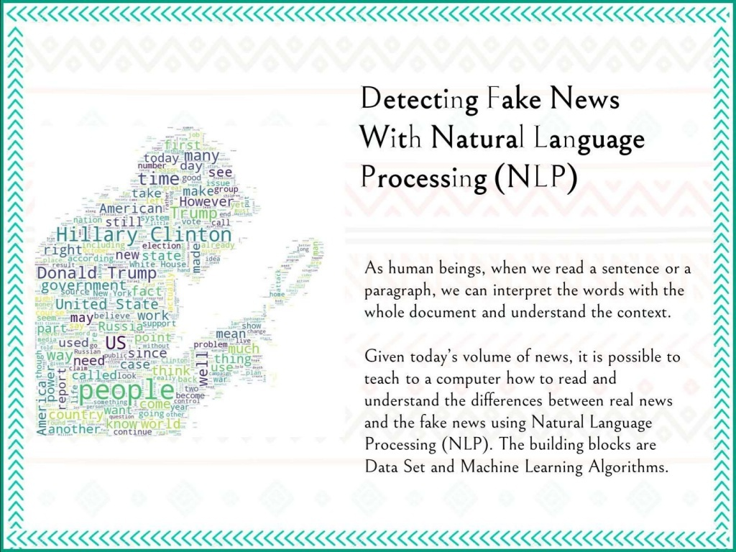

Slide 11
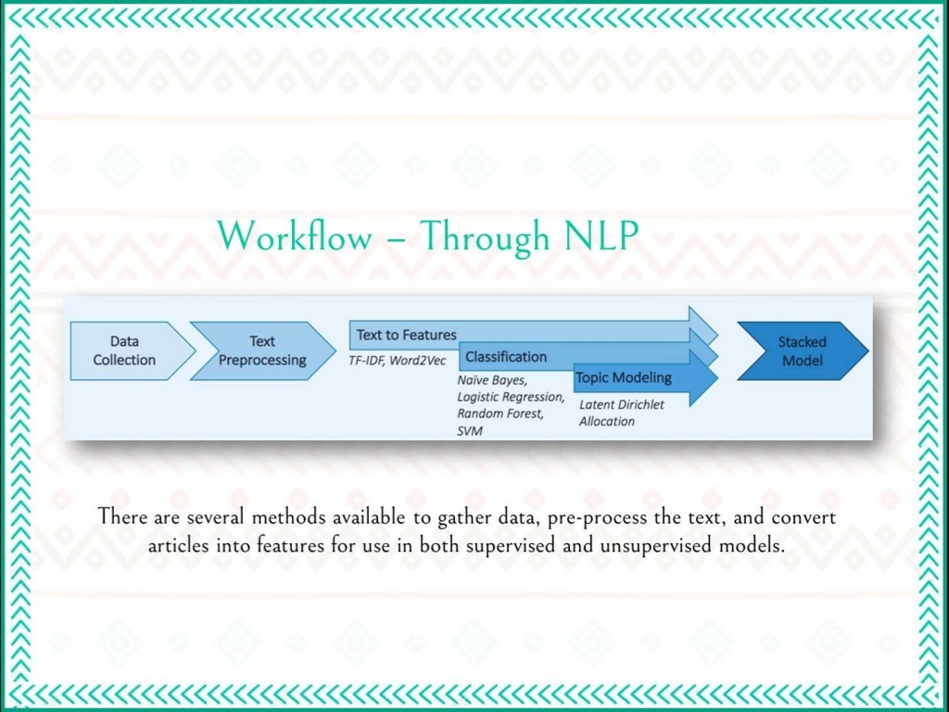

Slide 12
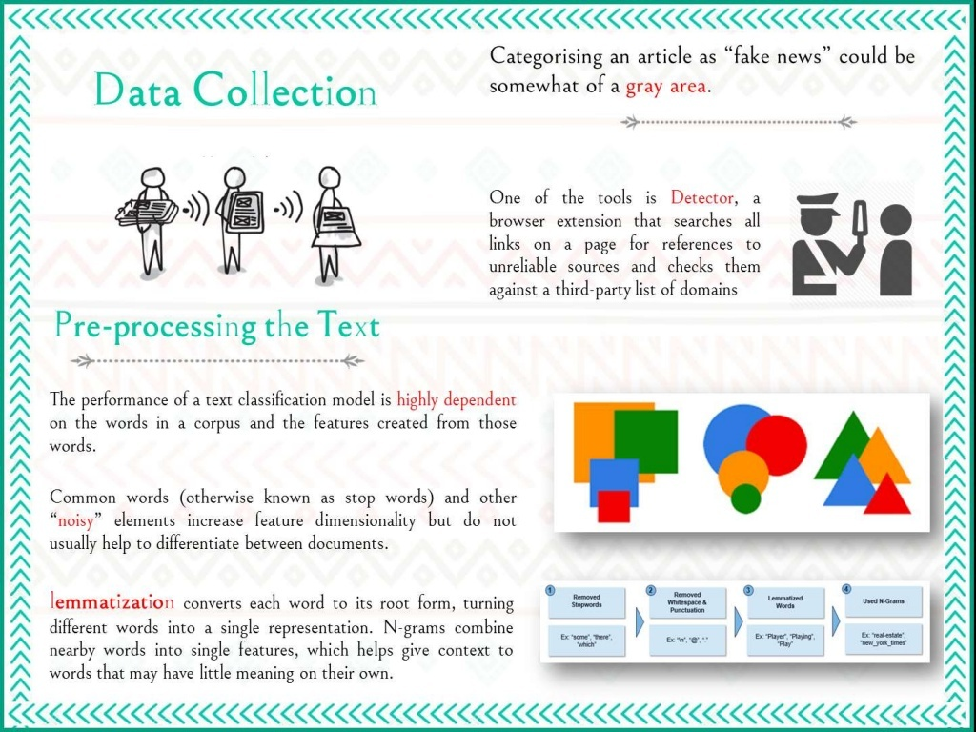

Slide 13
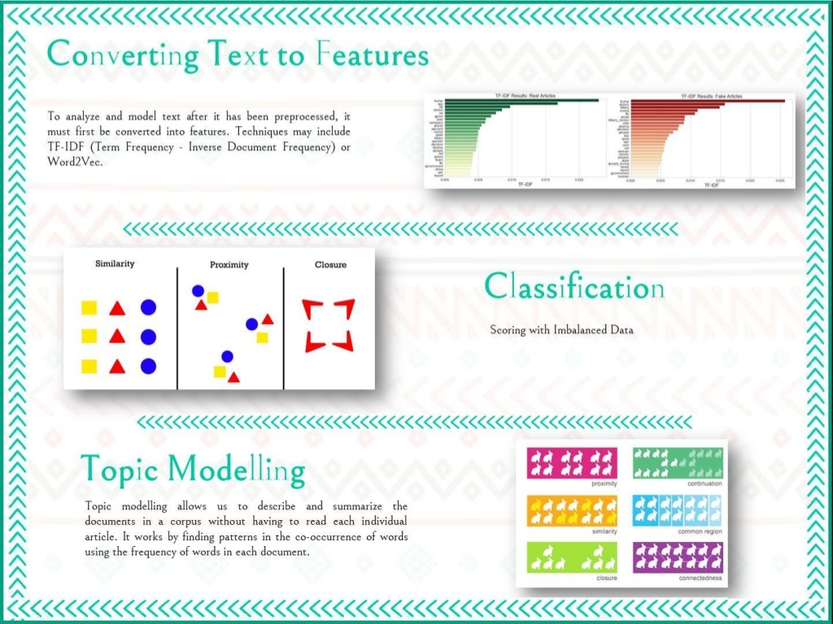

Slide 14
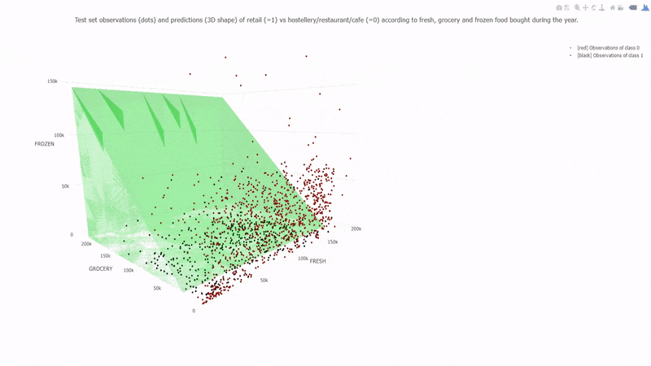
REPRESENTAION OF DATA

Slide 15
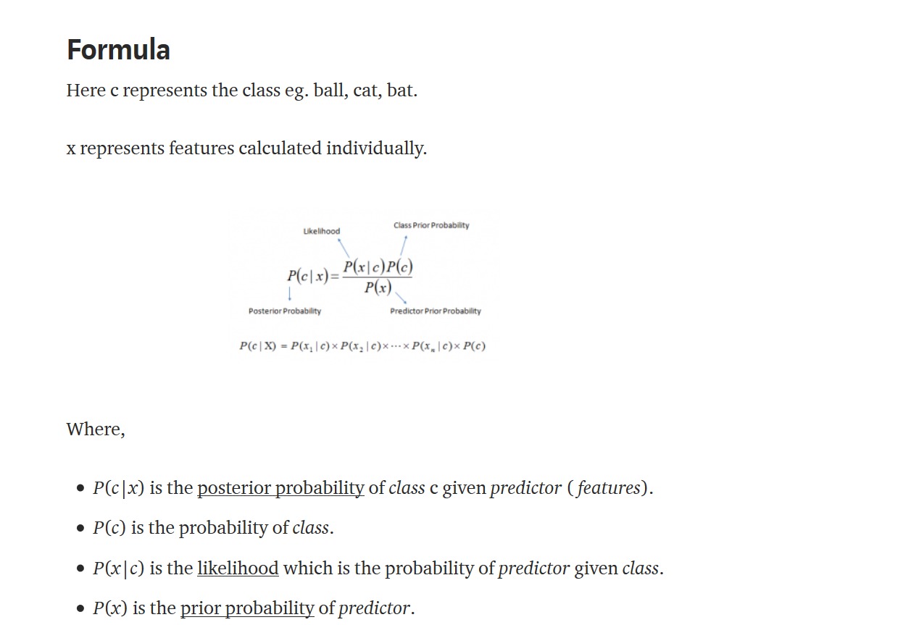

Slide 16
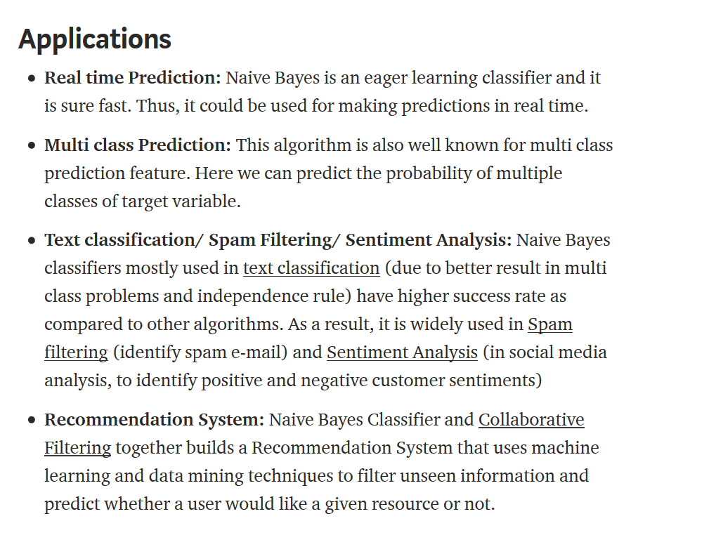

Slide 17
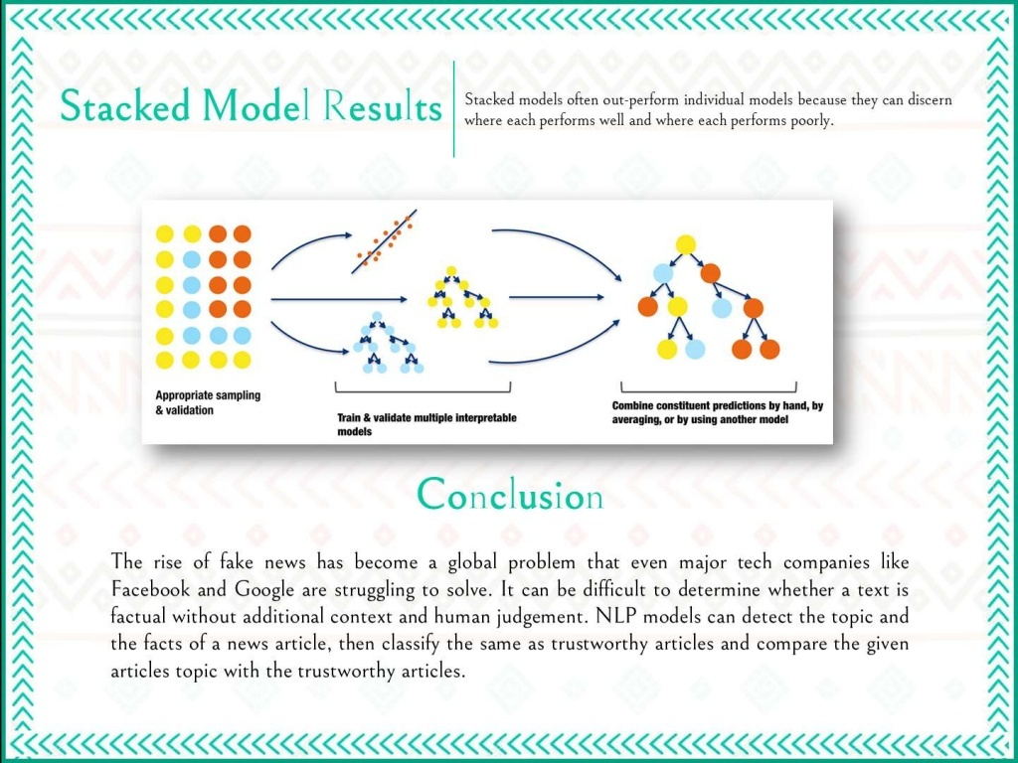

Slide 18
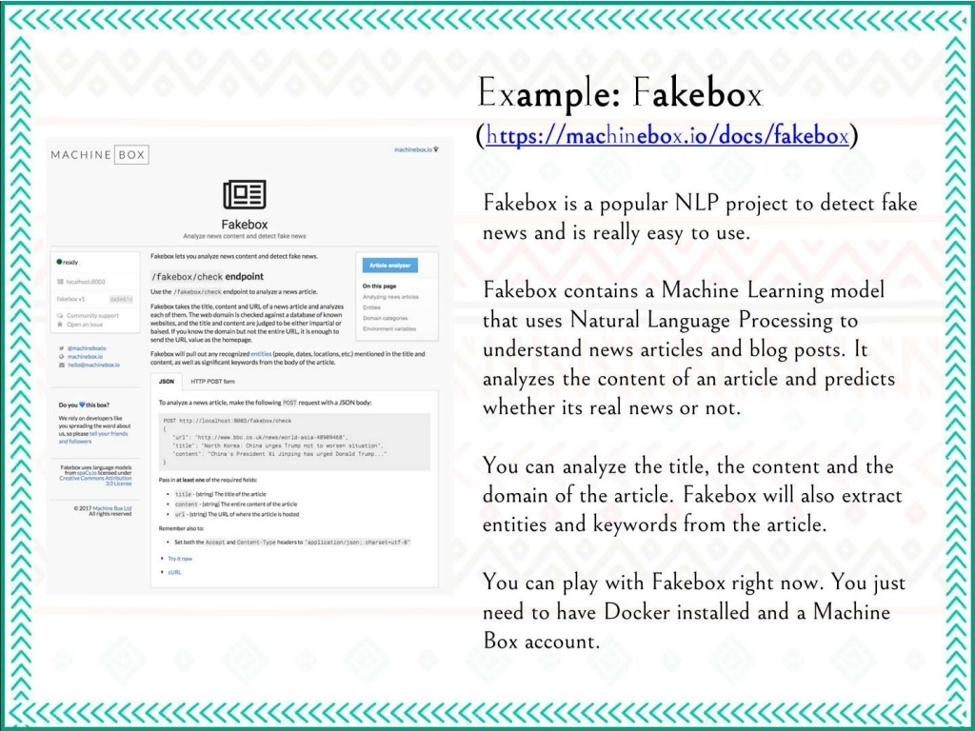

Slide 19
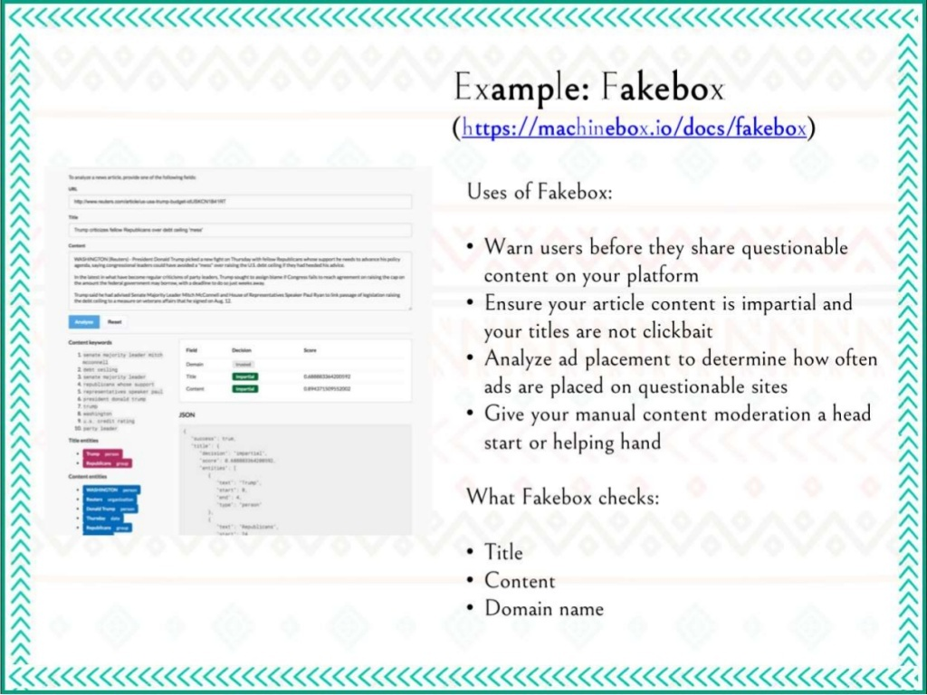

Slide 20
BIBLIOGRAPHY
In this project we have taken help from Kaggle(mainly dataset) ,YouTube,
Some various sites for understanding algorithm like naïve Bayes text classification from sites like https://towardsdatascience.com/, Kaggle.

